Slide 1
Google Analytics Report (Using GA & GoogleAnalyticsR) Traveller’s World
By: RAJSHRI TOTLA

Slide 2
ABOUT
Weblink : https://sites.google.com/bu.edu/traveller/
How users can use?
For famous tourist attractions
Reference for travel itinerary
How businesses can use it?
To know people’s travel interest
Demographically
Age Wise
Most desirable places, etc

Slide 3
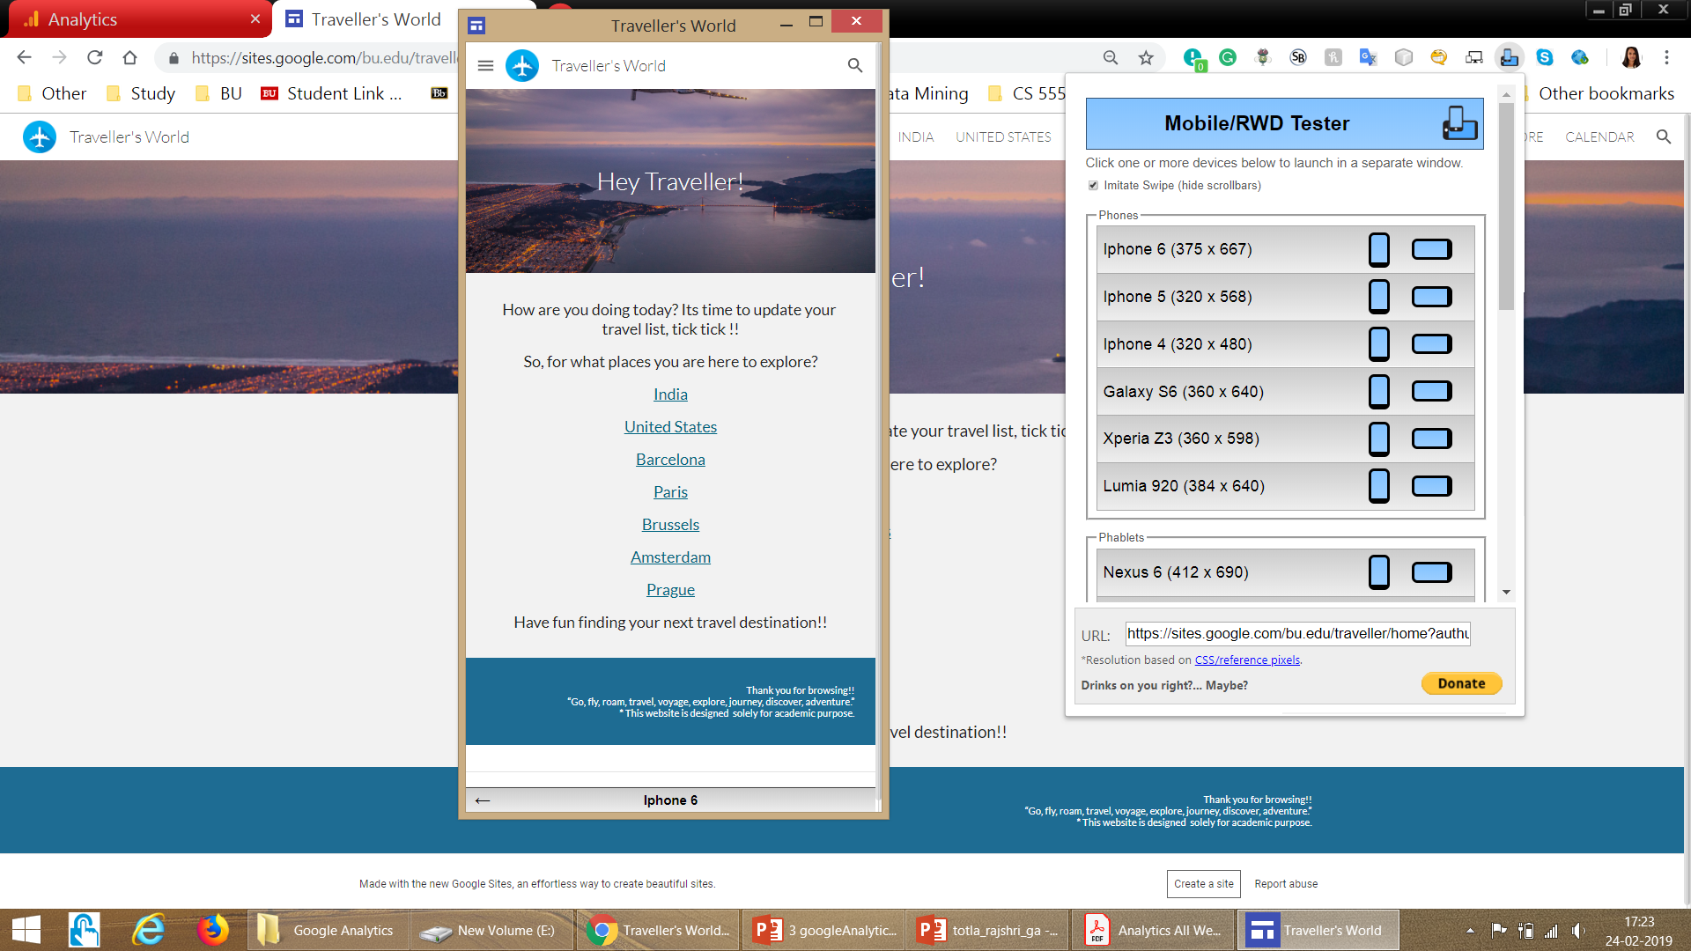
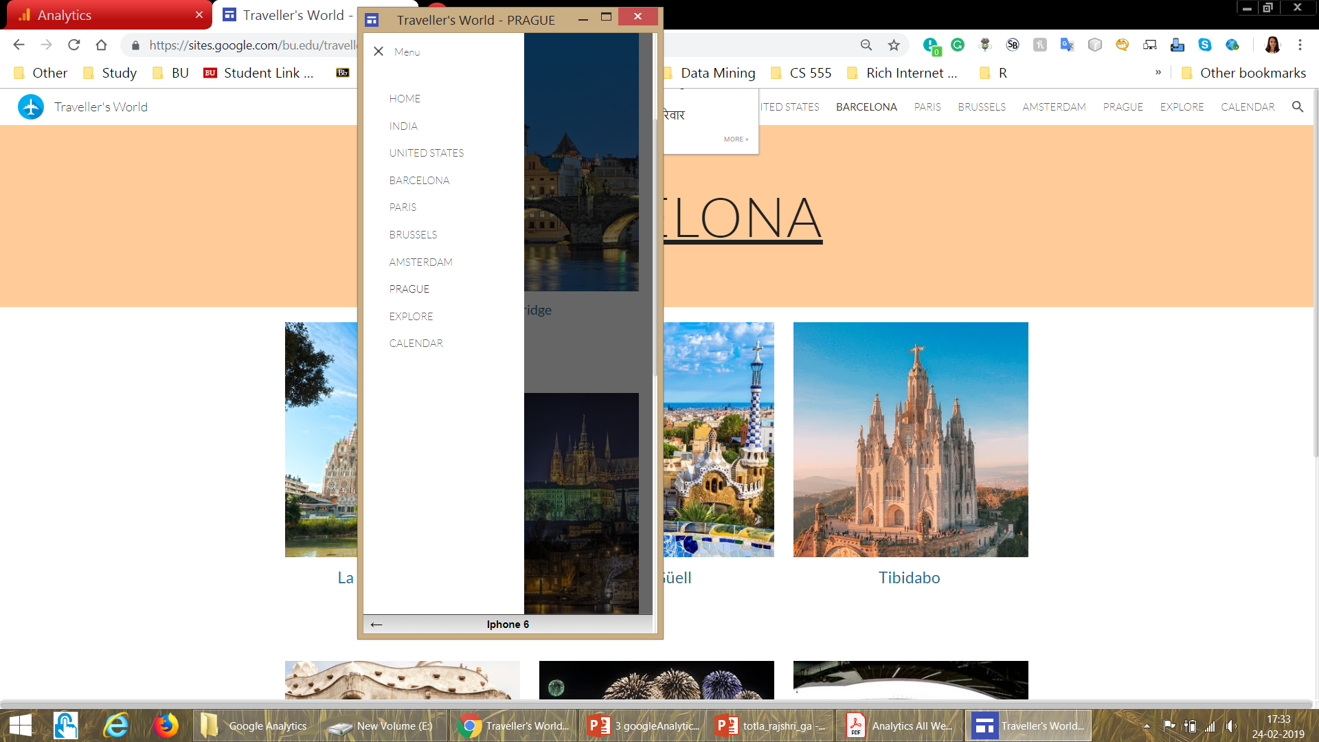
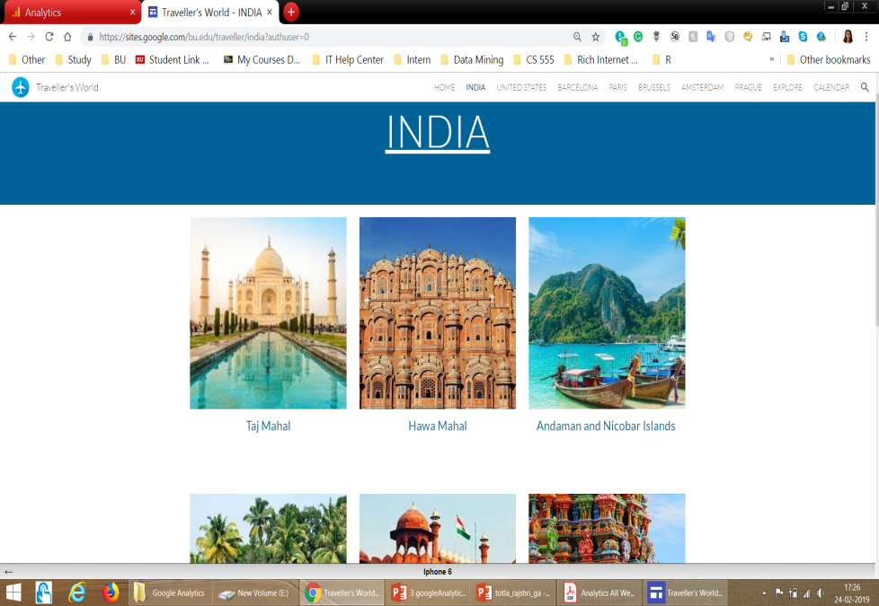
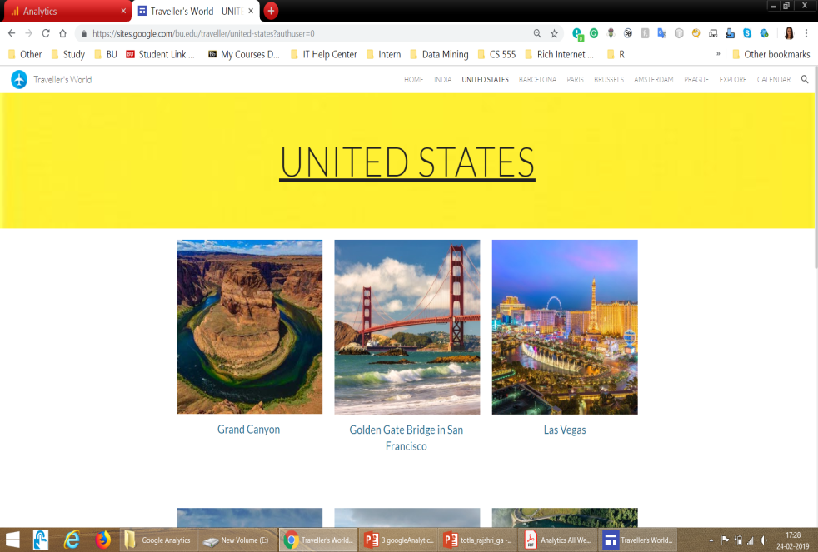
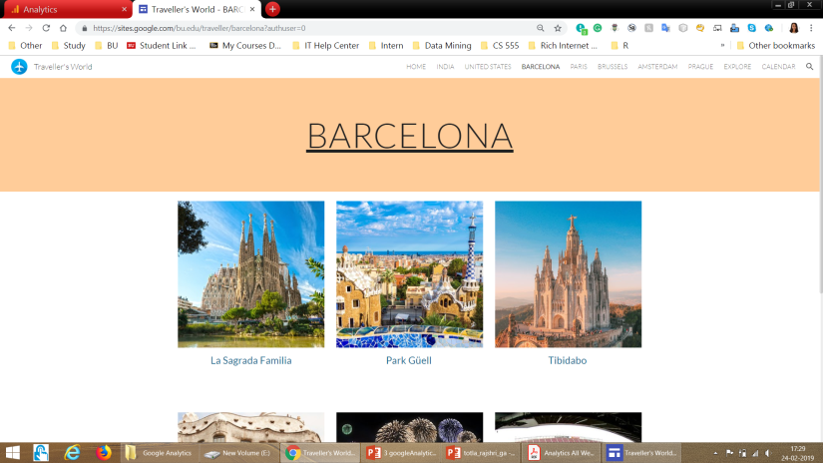
WEBSITE SNIPPETS

Slide 4
ANALYZED DATA INTERPRETATION
Travel agencies
Clear requirements / Target customers
Can make predicted, tailored & better travel itineraries
More customers, more business
Advertisers
Know what and where to advertise
Product companies

Slide 5
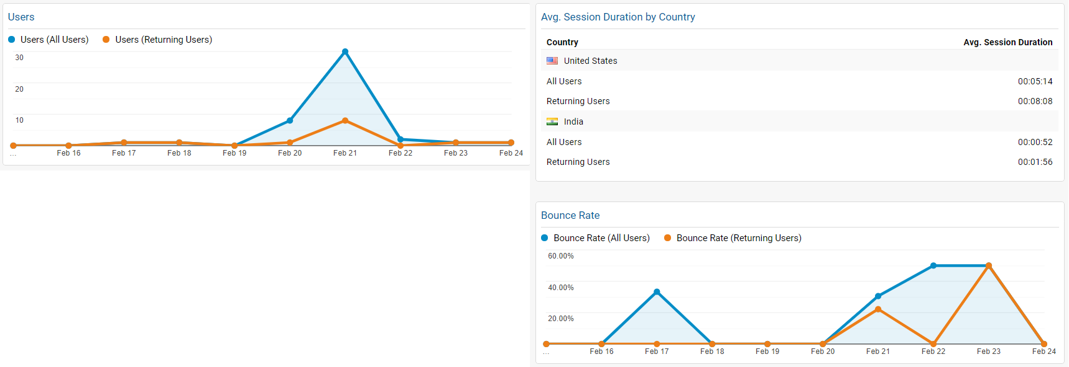
OVERVIEW
Users: Total no of users visited website in last 8 days
Country: Demographic distribution of users
Bounce Rate: Users who left promptly

Slide 6
GOALS

Slide 7

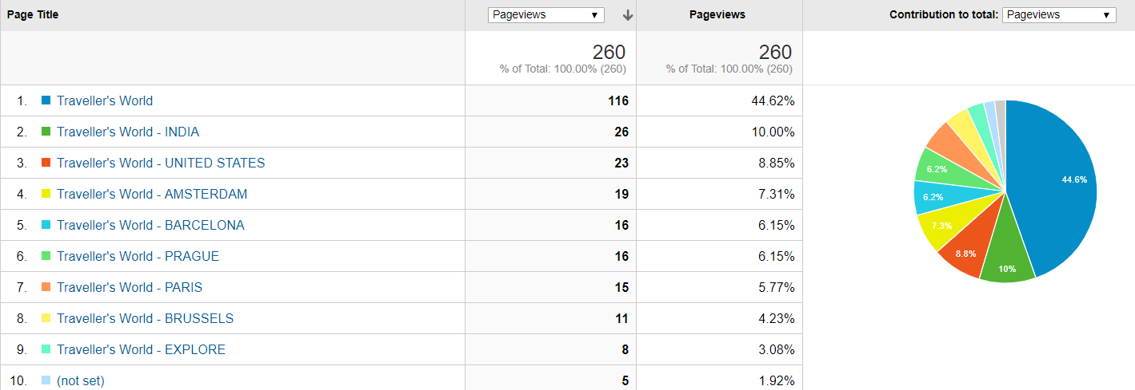



Which place users are most interested to travel? Proportional to number of page visits India USA Amsterdam

Slide 8
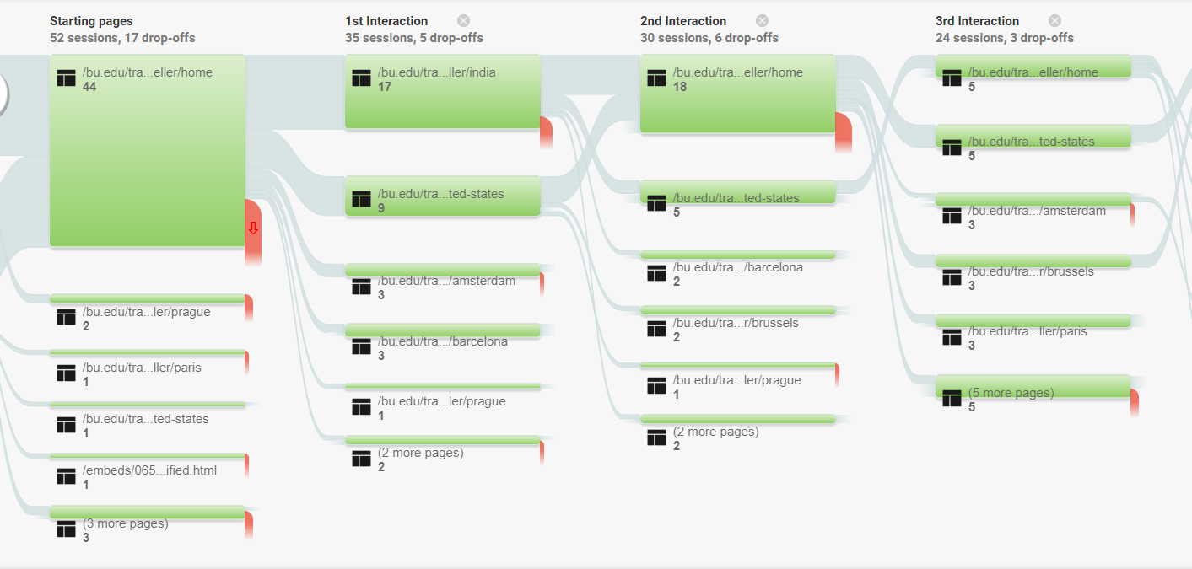
User Interaction Flow

Slide 9
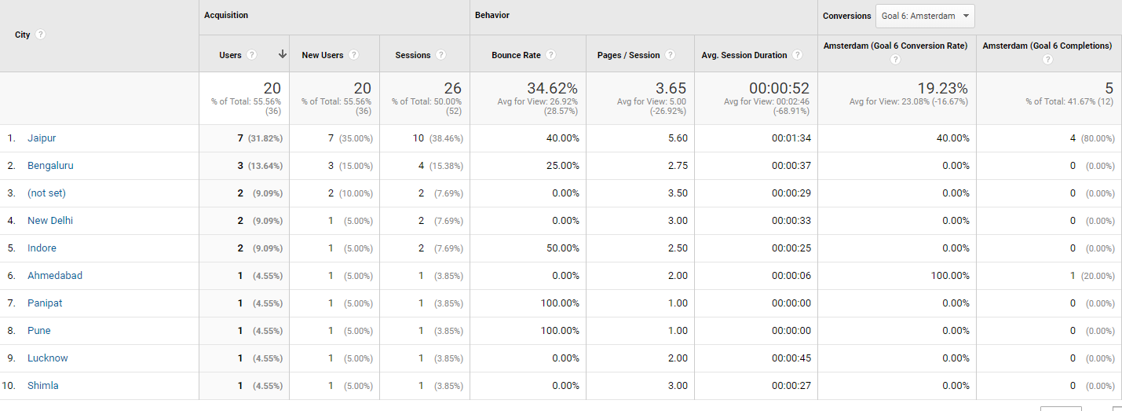
How many people from India (state wise) are interested in Amsterdam?

Slide 10
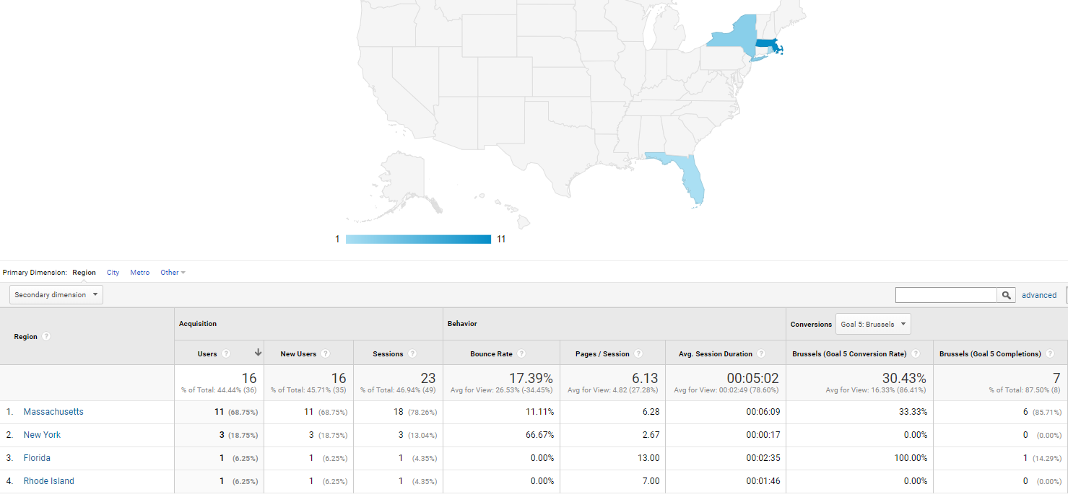
How many people from United States (state wise) are interested in Brussels?

Slide 11
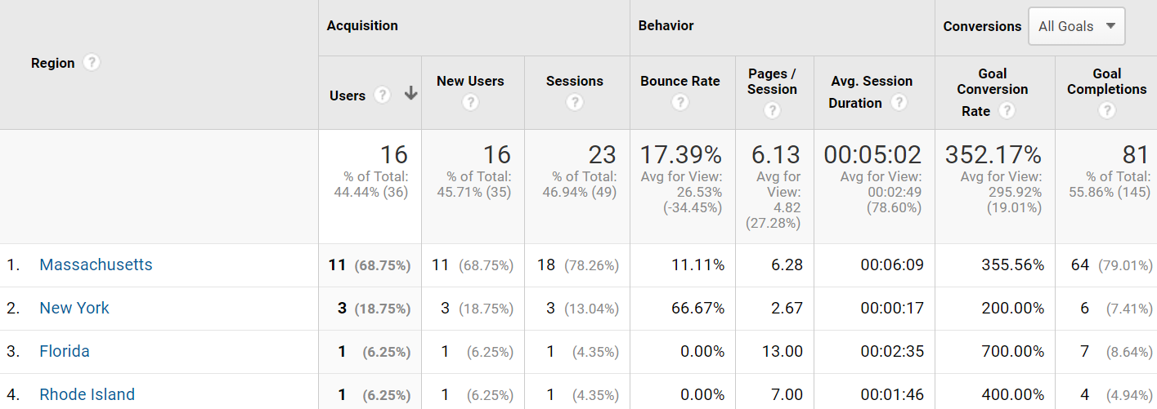
Which US state is best to start or promote travel business?

Slide 12
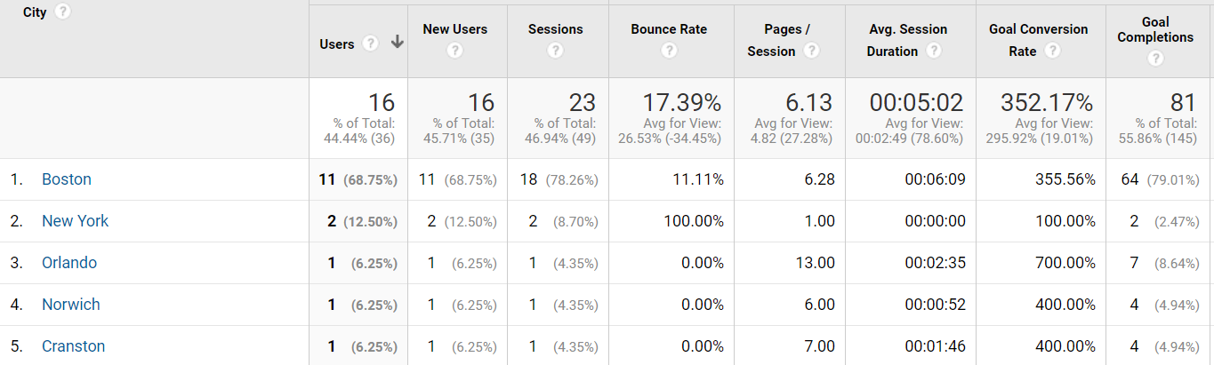
Which US state & city is best to start or promote travel business?

Slide 13
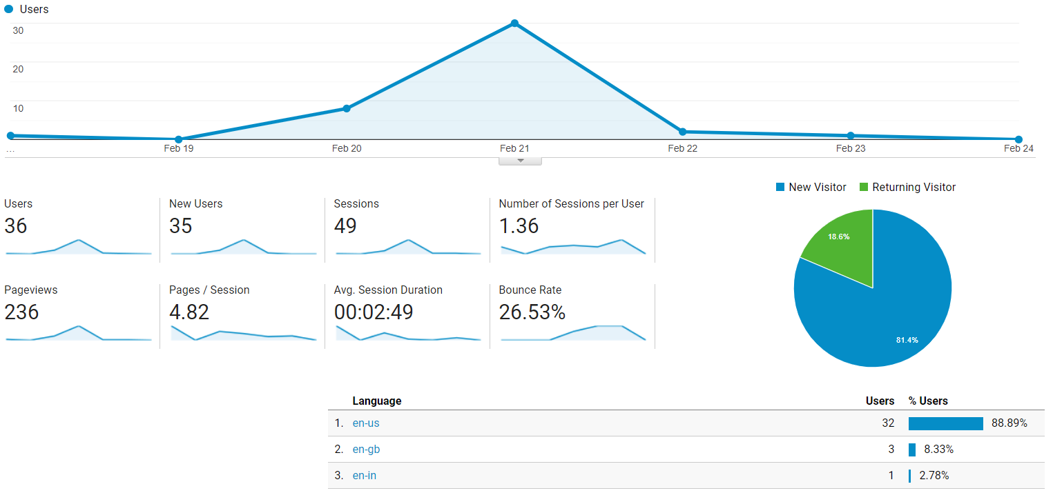
Languages website should support in order to increase number of visitors & increase user ease experience

Slide 14
Using GoogleAnalyticsR API

Slide 15
R CODE SNIPPET
library(googleAnalyticsR)
library(googleAuthR)
library(ggplot2)
ga_auth(".httr-oauth")
my_accounts <- ga_account_list()
google_analytics(my_id,
date_range = c("2019-02-18", "2019-02-23"),
metrics = c("sessions","pageviews",
"entrances","bounces"),
dimensions = c("date","deviceCategory",
"channelGrouping"),
anti_sample = TRUE)

Slide 16
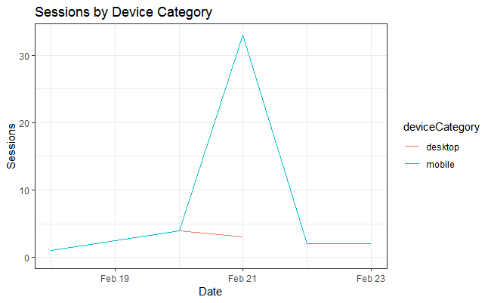
Sessions by Device Category google_analytics(my_id, date_range = c("2019-02-18", "2019-02-23"), metrics = c("sessions","pageviews", "entrances","bounces"), dimensions = c("date","deviceCategory", "channelGrouping"), anti_sample = TRUE)

Slide 17
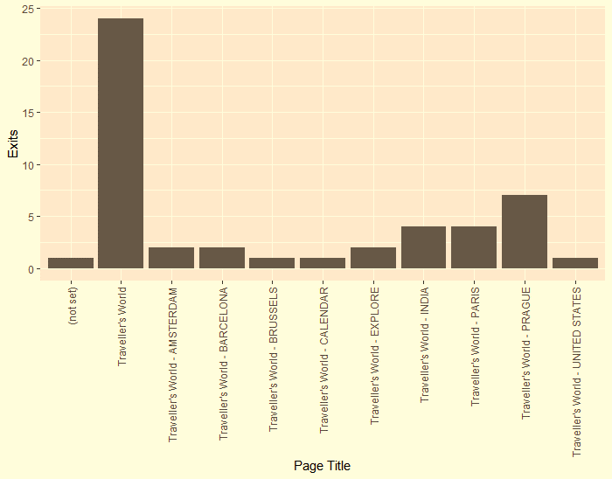
Number of exits/Page google_analytics(my_id, date_range = c("2019-02-18", "2019-02-23"), metrics = c("ga:exits"), dimensions = c("ga:pageTitle"), anti_sample = TRUE)

Slide 18
CONCLUSION
Page hits directly proportional to user interests
Bounce rate indirectly proportional to user interests
Explored data Country->State->Regions
Other options: device category, operating systems, network providers, etc

Slide 19
Thank You!

